Slide 1
Presentation Title
Subtitle

Slide 2
Presentation Title
Subtitle

Slide 3
Agenda
1
Agenda 1
2
Agenda 2
3
Agenda 3
4
Agenda 4

Slide 4
Century Gothic (Headings), 36 pts
Calibri (Body), 24 pts

Slide 5
Century Gothic (Headings), 36 pts
Calibri (Body), 24 pts

Slide 6
Century Gothic (Headings), 36 pts
Calibri (Body), 24 pts

Slide 7
Century Gothic, 44 pts
Century Gothic, 20 pts

Slide 8
Century Gothic, 44 pts
Century Gothic, 20 pts

Slide 9
Century Gothic, 44 pts
Century Gothic, 20 pts

Slide 10
Closing Slide

Slide 11


Comparison Infographic
Before
After
Item 1
MetaSource:
Item 1
Item 2
Item 2
One provider, one platform, one proven process.
Item 3
Item 3
Item 4
Item 4
Notes:
A combination of best-in-class technology, intelligent document processing, business rules-based workflows, and customer care
We do this all day every day – it’s at our core
All of the components of the solution

Slide 12

Process Infographic
Process
Step 1
Step 5
Step 2
Step 4
Step 3

Slide 13
Intelligent Loan Boarding Benefits
Quickly and accurately “de-blob” incoming files
Enhance the customer experience
Review exceptions only
Increase the quality of pre-classified loan files
Minimize the risk of onboarding defective loans
Efficiently manage high loan volumes

Slide 14
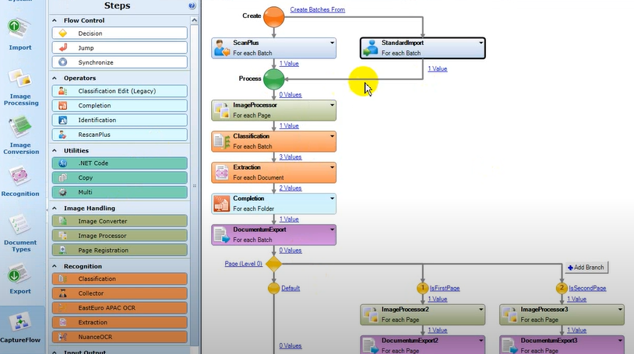
IDP: Accuracy
& Efficiency
AWR-specific workflows
Logic-based exception handling
OCR & human-in-the-loop

Slide 15
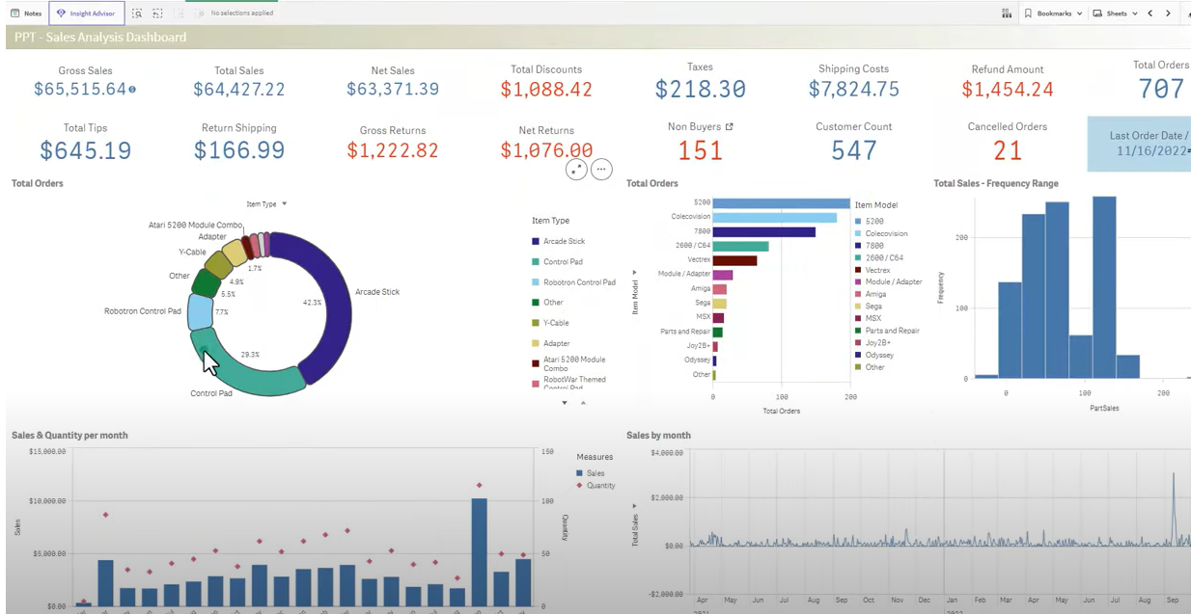
End-to-End Transparency & Control
Robust insights & analytics
Real-time visibility
Fully customized to AWR's business needs
Notes:
If we have the data, we can report on it
Source BI Slide – and this is how you see all of it, one-stop shop, you’re in control

Slide 16
Inbound & outbound support
First-call resolution
Outreach that ensures a positive reflection of AWR​’s values
Highly trained, professional staff
Outbound correspondence support
Email support
Defined, measured & calibrated outcomes
Notes:
Customer care slide

Slide 17
Structured & formalized implementation
Strategic account management & executive support
Deep industry expertise & bench strength
Subject matter expertise & white-glove service every step of the way

Slide 18
30+
2 billion
3,000+
20%
10 billion
270 million
8
years’ experience
3,000+ software installations
of all loans serviced in the U.S. run through our technology
U.S. centers of excellence
characters captured annually
images captured annually
images hosted
Tap into our expertise.
Rely on our experience.

Slide 19







Industry leaders trust MetaSource
Top 10 credit card issuers & consumer finance lenders
Industry-leading insurance & healthcare companies
The largest court systems in the nation
14 state & local housing finance agencies
800+ mortgage clients
Major debt relief companies

